Slide 1
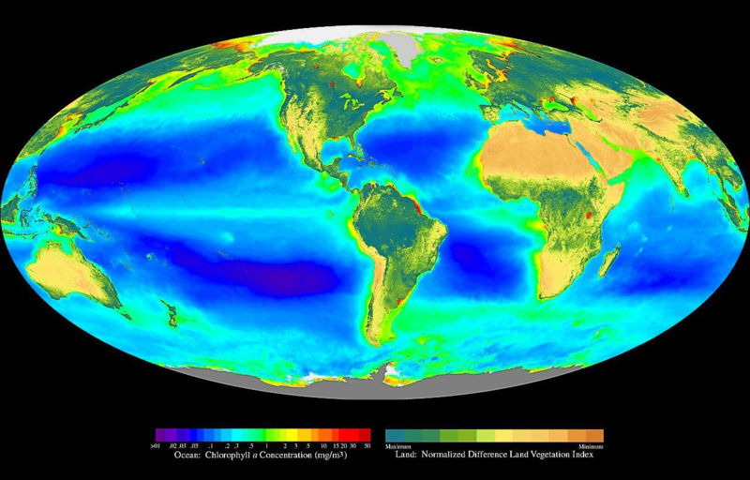
“Each day as the sun rises and retires the beautiful green bays like great Creatures breathe in and out. By day photosynthetic production of food and oxygen is Plentiful, but day and night there is also a furious feasting.”
– Odum and Hoskin 1958
SeaWiFS Global Biosphere September 1997 - August 1998
This composite image gives an indication of the magnitude and distribution of global primary production, both oceanic (mg/m³ chlorophyll a) and terrestrial (normalized difference land vegetation index).

Slide 2
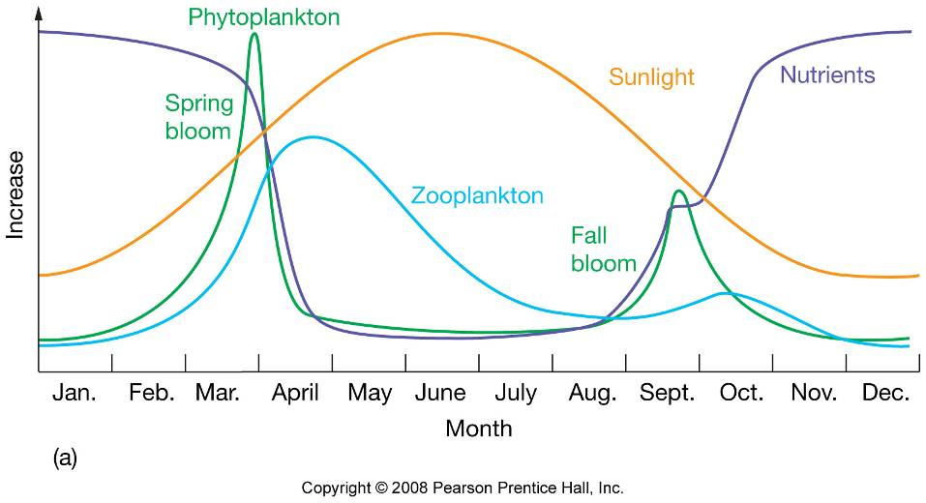
Primary productivity in temperate oceans

Slide 3
Primary production
Primary Production: Organic matter synthesized from inorganic substances.
Photosynthesis: producing organic matter from carbon dioxide and water using Light energy.
Carbon dioxide + Water + Light → Organic matter + Oxygen
6CO₂ + 6H₂O + Light → C₆H₁₂O₆ + 6O₂
Photosynthesis consumes CO₂ and produces O₂

Slide 4

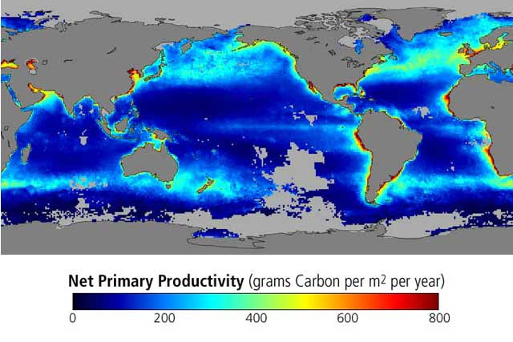
Key Terms:
Biomass – static measure
of how much,
e.g. – how many grams?
Primary Production – dynamic measure of how much is
(made) produced per unit time,
e.g. – how many grams per day?

Slide 5
Controls on primary productivity
Photosynthetic light.
Dissolved inorganic nutrients.
Grazing by zooplankton.

Slide 6
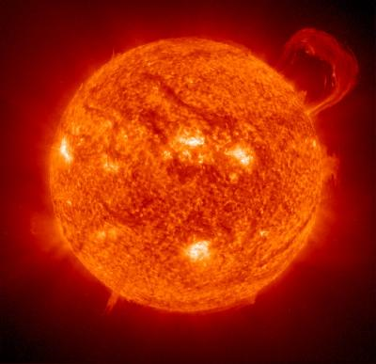

What limits primary production in the ocean?
Most common limiting factors:
Light
Nutrients

Slide 7
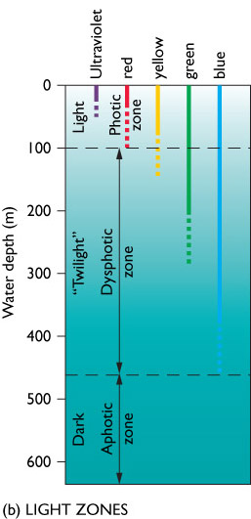
  The photic zone is the depth where light is sufficient for photosynthesis.
  The dysphotic zone is where illumination is too weak for photosynthesis.
  The aphotic zone receives no light from the surface because it is all absorbed by the water above.

Slide 8
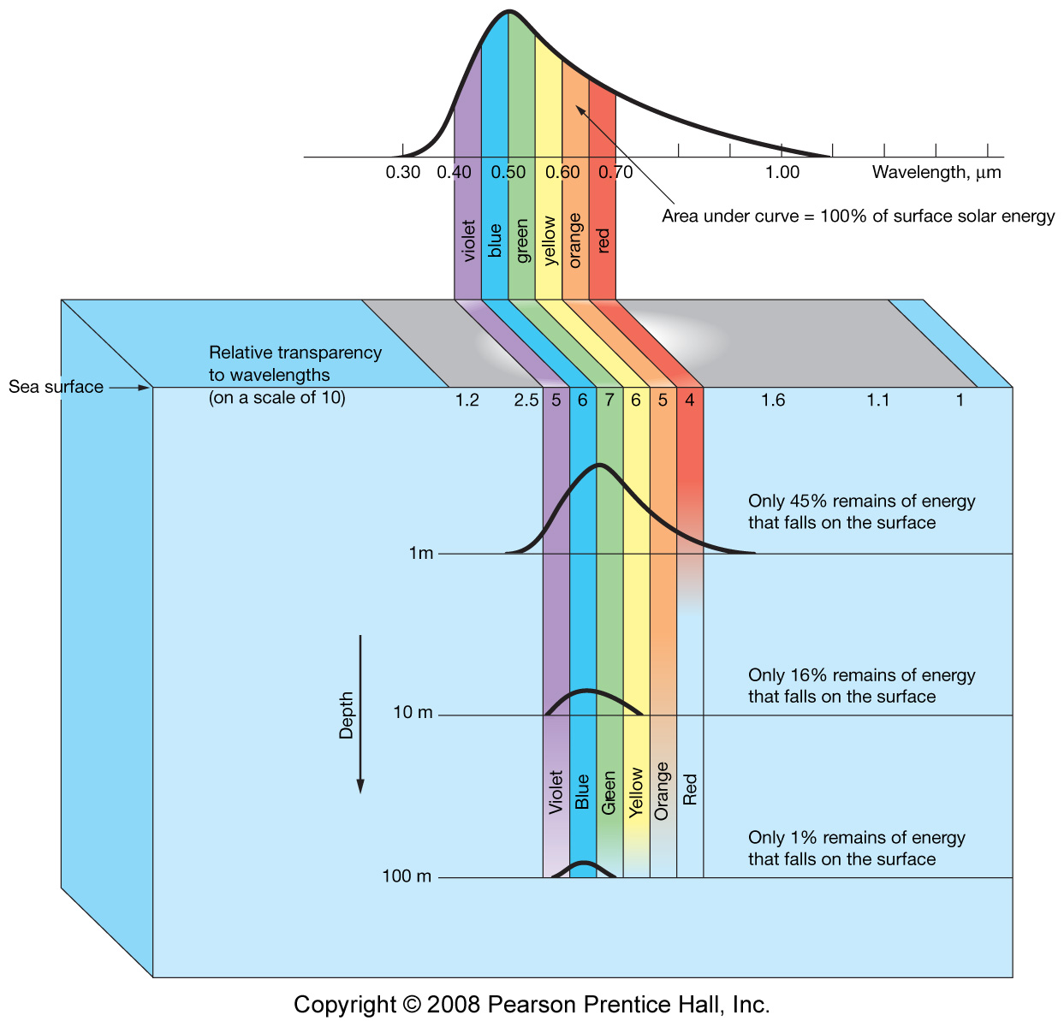
Ultraviolet
Infrared
PAR: photosynthetic active radiation
(400-700 nanometers)
Euphotic
Zone

Slide 9
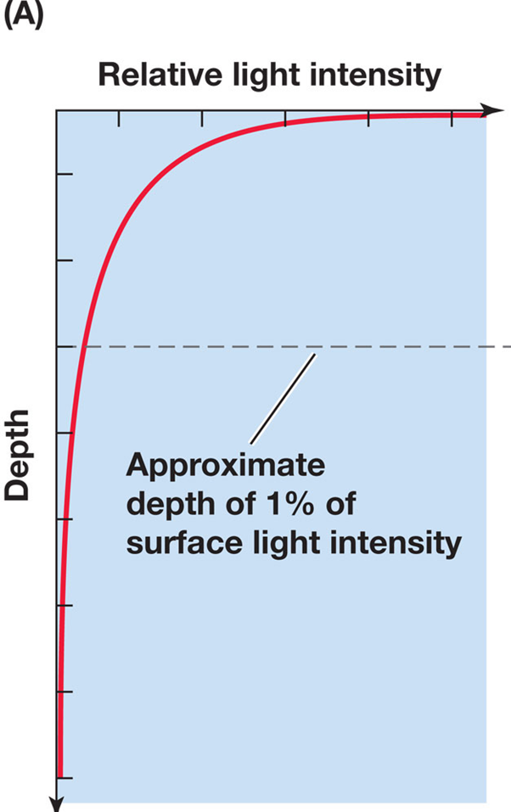
1% light level

Slide 10
Major nutrients?
Carbon: important but abundant in seawater.
Nitrate (NO₃⁻), Nitrite (NO₂⁻), Ammonium (NH₄⁺)
Phosphate (PO₄³⁻)
Silicate (SiO₄)
106CO₂ + 16NO₃⁻ + PO₄³⁻ + 122H₂O + 19H⁺ + Light
→ (CH₂O)₁₀₆(NH₃)₁₆(H₃PO₄) + 138O₂
Redfield ratio C:N:P = 106:16:1 (in phytoplankton)
Diatoms?
C:N:P:Si → 106:16:1:16

Slide 11
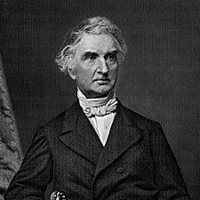
Justus von Liebig
“Father of Fertilizer Industry”
(May 12, 1803 - April 18, 1873)
1855: Liebig’s Law of the Minimum: By the deficiency or absence of one necessary constituent, all others being present, the soil is rendered barren for all crops to the life of which that one constituent is indispensable. With equal supplies of the atmospheric conditions for the growth of plants, the yields are directly proportional to the mineral nutrients supplied in the manure. In a soil rich in mineral nutrients, the yield of a field cannot be increased by adding more of the same substances"

Slide 12
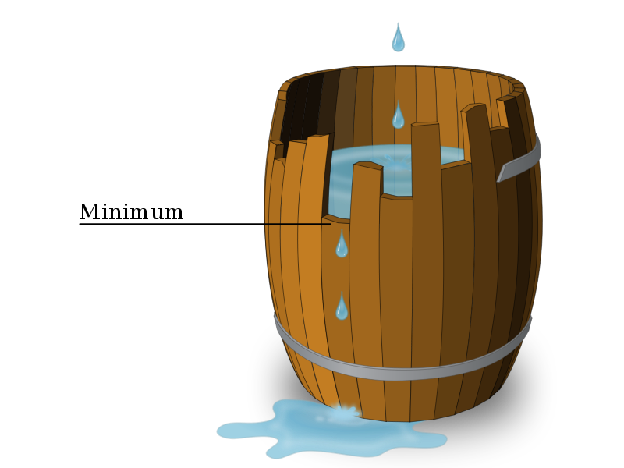
Leibig’s Law of the Minimum (for oceans):
Phytoplankton growth is determined by the response of
phytoplankton to the single factor that is most limiting.
These factors include N, P, Fe, Si, and other trace materials.

Slide 13
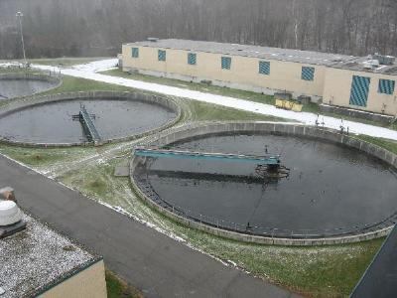
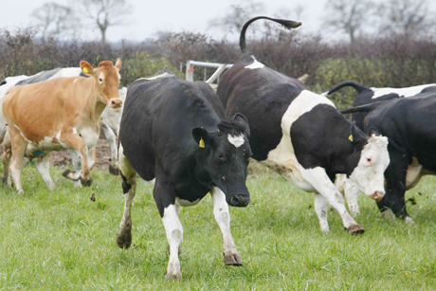
What are sources of nutrients to ocean?
Source of nutrients: Continents.
weathering, farm fertilizers → runoff
wastewater treatment plants….

Slide 14
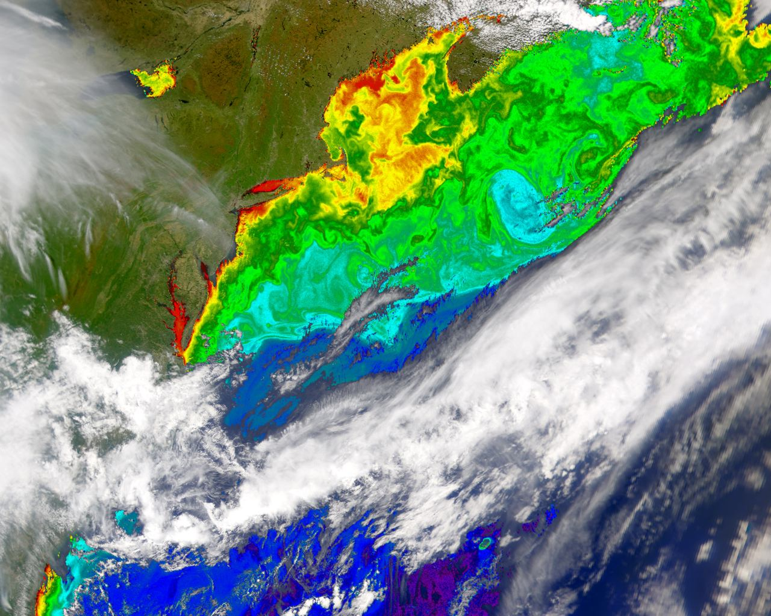

Slide 15
Primary production by phytoplankton
CO₂
Nutrients +
CO₂
phytoplankton
Surface Ocean

Slide 16
What are the products of respiration?
Oxygen
Carbon dioxide and nutrients
Organic matter
I don’t know

Slide 17
Respiration
Organic Matter + O₂ → CO₂ + NO₃ + PO₄ + H₂O
Respiration (remineralization, regeneration, degradation)
  consumes oxygen.
  produces carbon dioxide.
  regenerates nutrients.

Slide 18

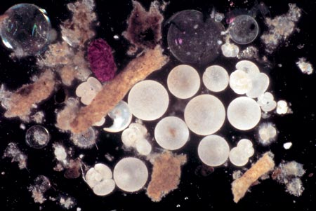
Marine Snow
Fecal pellets
Planktonic tests
www.whoi.edu/oceanus
Sinking particles collected in a sediment trap

Slide 19
Let’s draw…….
What would a profile of O₂ w/ depth look like?
How about dissolved inorganic nitrogen?
[O2]
Epi-pelagic zone
~1000
Depth, m

Slide 20
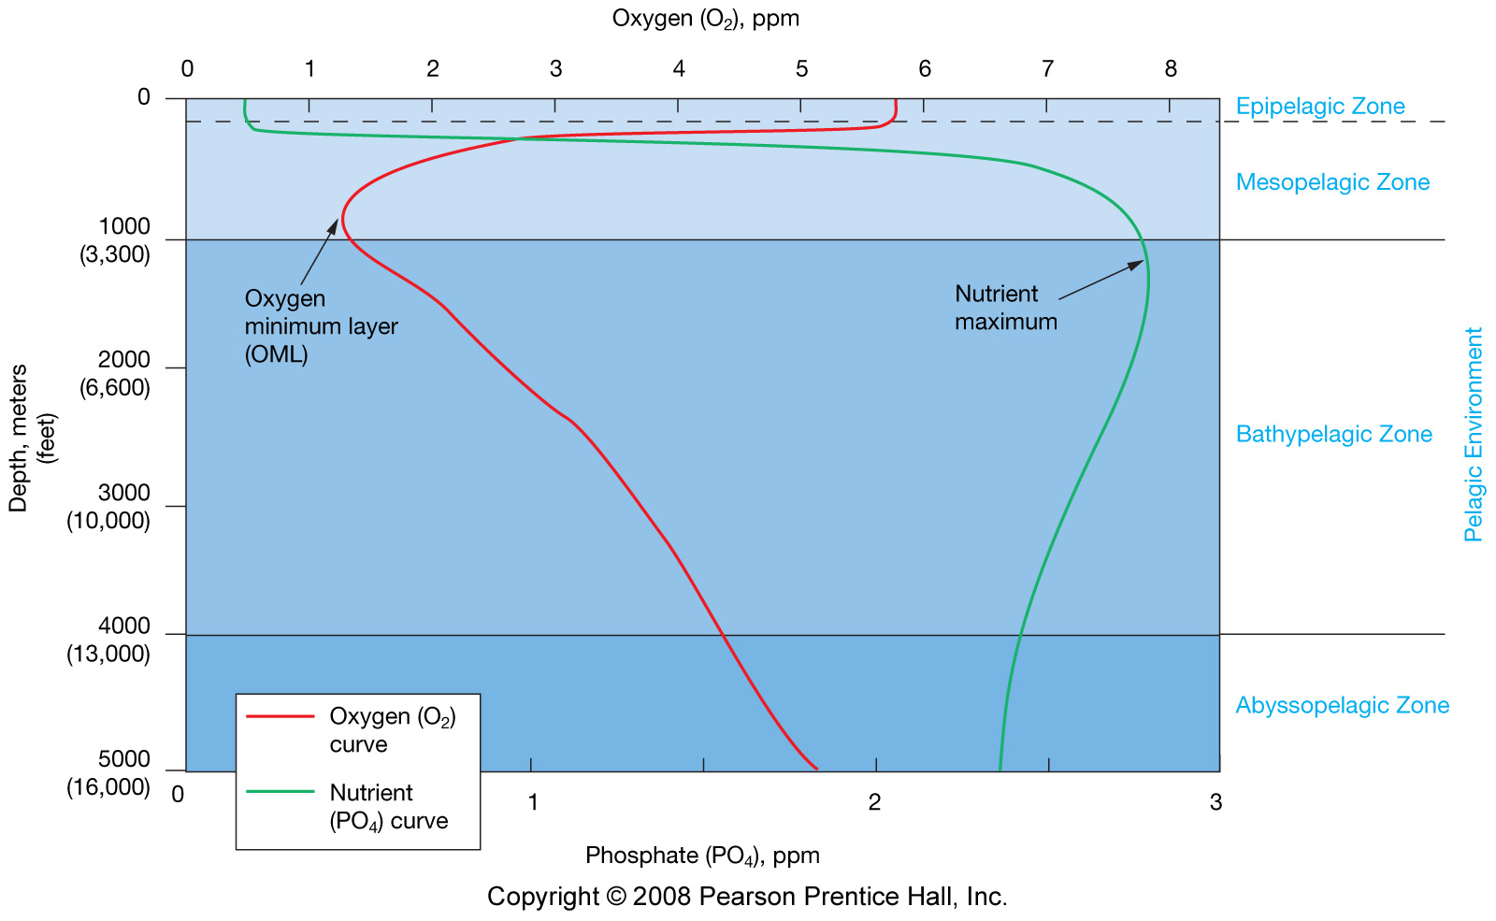
Depleted by
photosynthesis
Remineralization
75% of ocean
Nutrient remain high, O₂ high – because it’s replenished with
High oxygen cold water from polar regions….

Slide 21
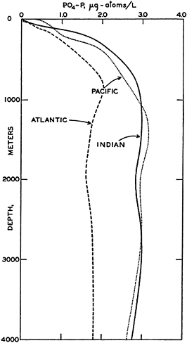
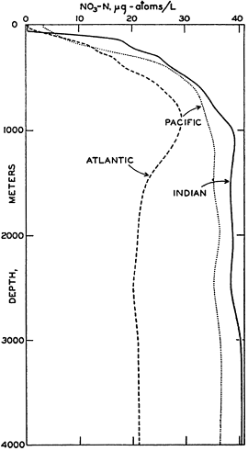
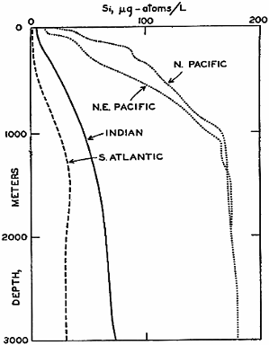
Vertical distribution of nutrients
Depleted in surface water, abundant in deep water
PO₄
NO₃
Si

Slide 22
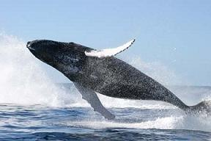
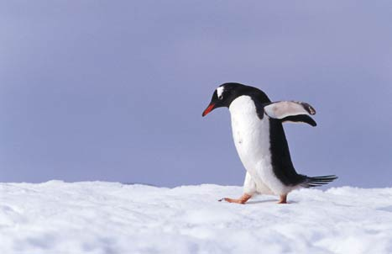
When do you get a phytoplankton
bloom???
Why do we care?

Slide 23
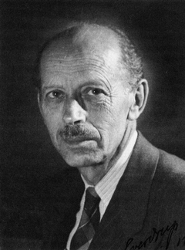

Sverdrup's Model of Critical Depth
  Photosynthesis decreases exponentially with depth due to decrease in light availability
  Respiration is unaffected by light and remains
  constant with depth

Slide 24
Sverdrup's Model of Critical Depth
Too much light including harmful UV prohibits photosynthesis
Euphotic zone
Photosynthesis rate
~100m
Depth
Respiration rate

Slide 25
Sverdrup's Model of Critical Depth
Euphotic zone
Photosynthesis rate
Compensation Point:
Rate of Photosynthesis = Rate of Respiration
~100m
Depth
Respiration rate
Operationally defined as
The depth at which 1%
Of surface light occurs.

Slide 26
Sverdrup's Model of Critical Depth
  Phytoplankton is mixed by turbulence and experiences different light intensities over time, sometimes above and sometimes below compensation point
  Critical depth = depth at which photo-synthesis
  of the TOTAL water column phytoplankton
  population equals their TOTAL respiration

Slide 27
Sverdrup's Model of Critical Depth
Euphotic zone
Photosynthesis rate
~100m
Depth
Critical Depth:
TOTAL Photosynthesis =
TOTAL Respiration
Respiration rate
A phytoplankton bloom –can only occur if mixing is shallower than this depth…..shallower than the critical depth. Only then is the population net production >0

Slide 28
Low latitude: strong thermocline → stratified.
High latitude: vertically well mixed.
High latitude
Temperature
Low latitude
Mixing
Depth

Slide 29
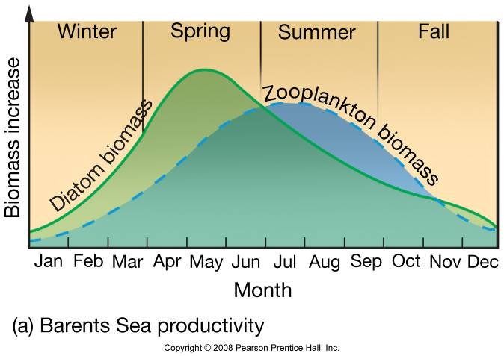
Primary productivity
Polar oceans:
  Nutrients are abundant due to vertical mixing.
  limited by sunlight: darkness for winter months.
  (partly) covered by sea ice.

Slide 30
Primary productivity in temperate oceans

Slide 31
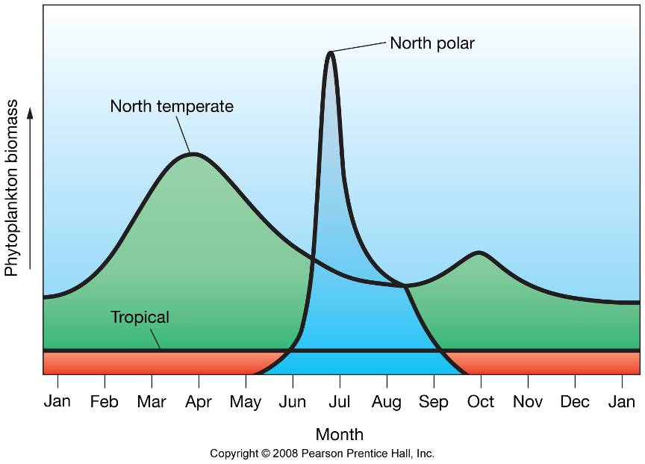
Primary productivity

Slide 32
How might we measure photosynthesis in the ocean?

Slide 33
Measurements of photosynthesis
Monitoring O₂ change in a dark bottle and a light bottle.
(dissolved oxygen is easy to measure)
  Light bottle: Photosynthesis – Respiration.
  Dark bottle: Respiration only.
  Gross photosynthesis: Light bottle – Dark bottle.
Photosynthesis
&
Respiration
Respiration
Light bottle Dark bottle

Slide 34
Measurements of photosynthesis
Monitoring ¹⁴C uptake
  Add dissolved ¹⁴C spike.
  After time duration, filter particles (organic matter produced).
  Measure ¹⁴C incorporated into particles.
  FYI
  Radioactivity of ¹⁴C is easy to measure when the concentration is VERY high (¹⁴C spike).
  Measurement of natural level is harder (one ¹⁴C out of a trillion ¹²C in nature).

Slide 35
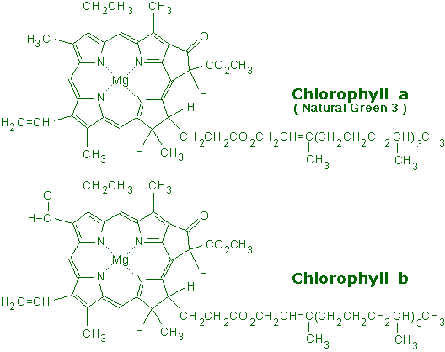
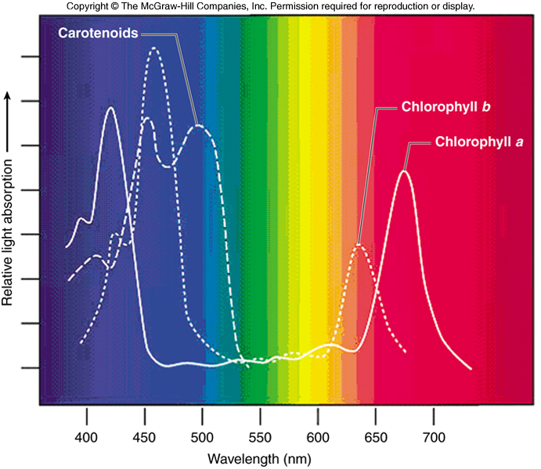
Measurements
Chlorophyll (Biomass measurement):
Pigments that absorb sun light (blue and red ends of the visible spectrum).
Can be monitored by fluorescence (in-situ instrument) and ocean color (satellites)
www.succulent-plant.com

Slide 36
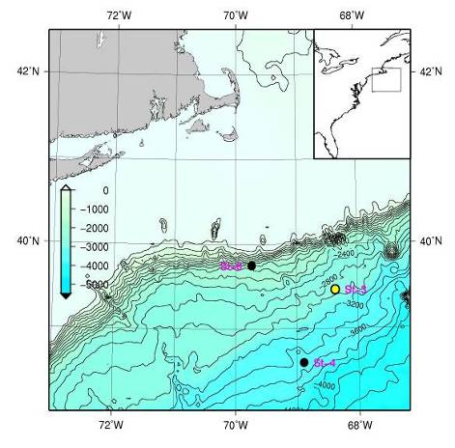
Chlorophyll
Depth (m)
Stn A, 2000m
Stn B, 3000m
Subsurface Chl.
max.
Stn C, 3500m

Slide 37
Chlorophyll
Productive along the continents.
Productive in the upwelling regions.
Deserts in centers of gyres (due to downwelling).

