Slide 1
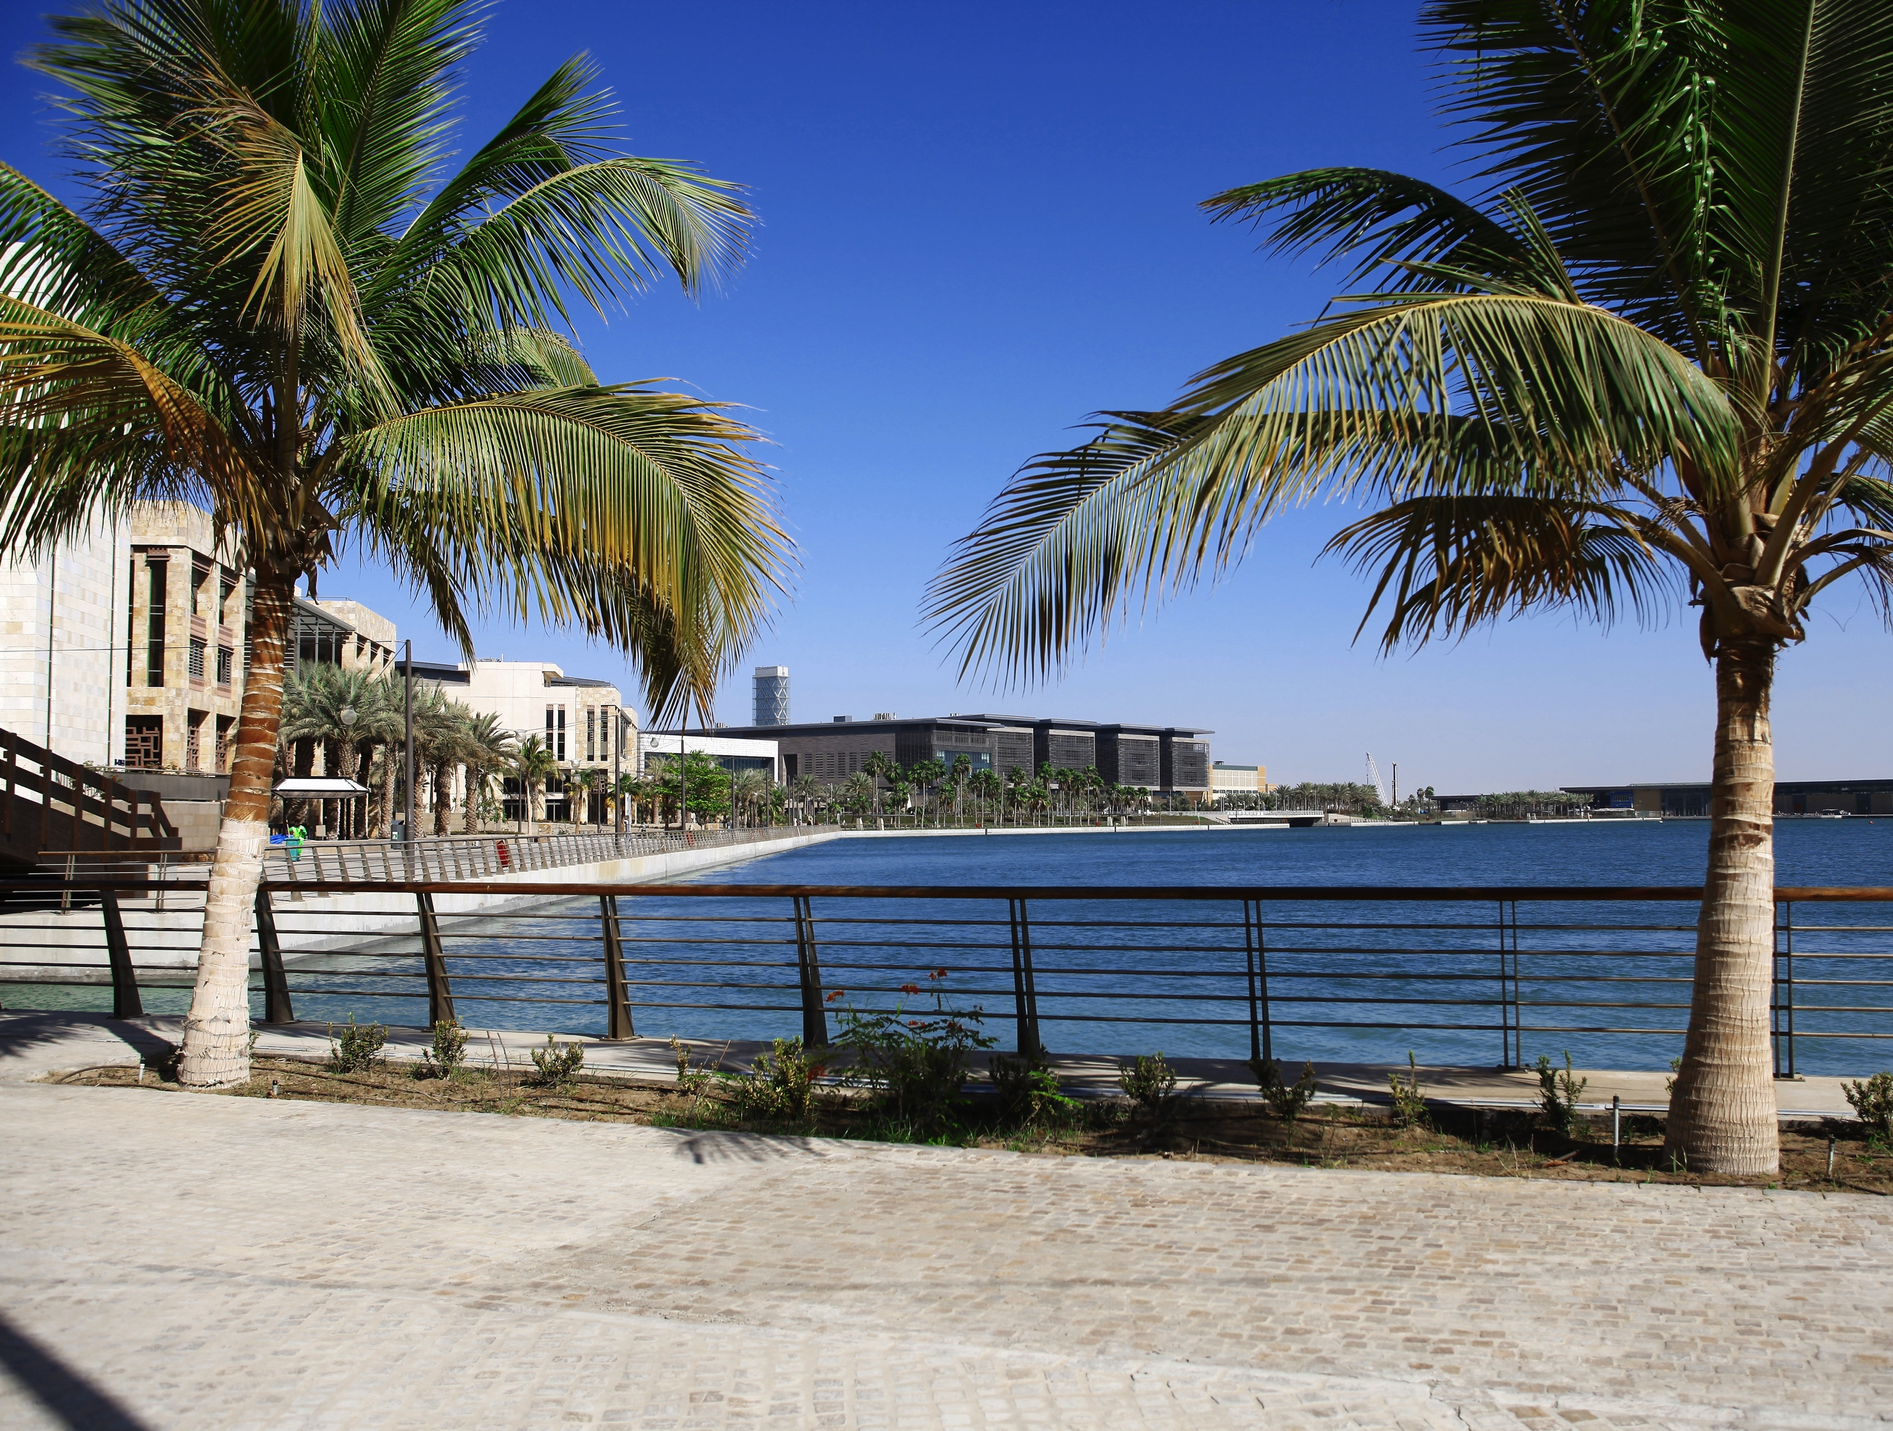
BIOLOGICAL & ENVIRONMENTAL SCIENCE & ENGINEERING DIVISION
AT KAUST

Slide 2
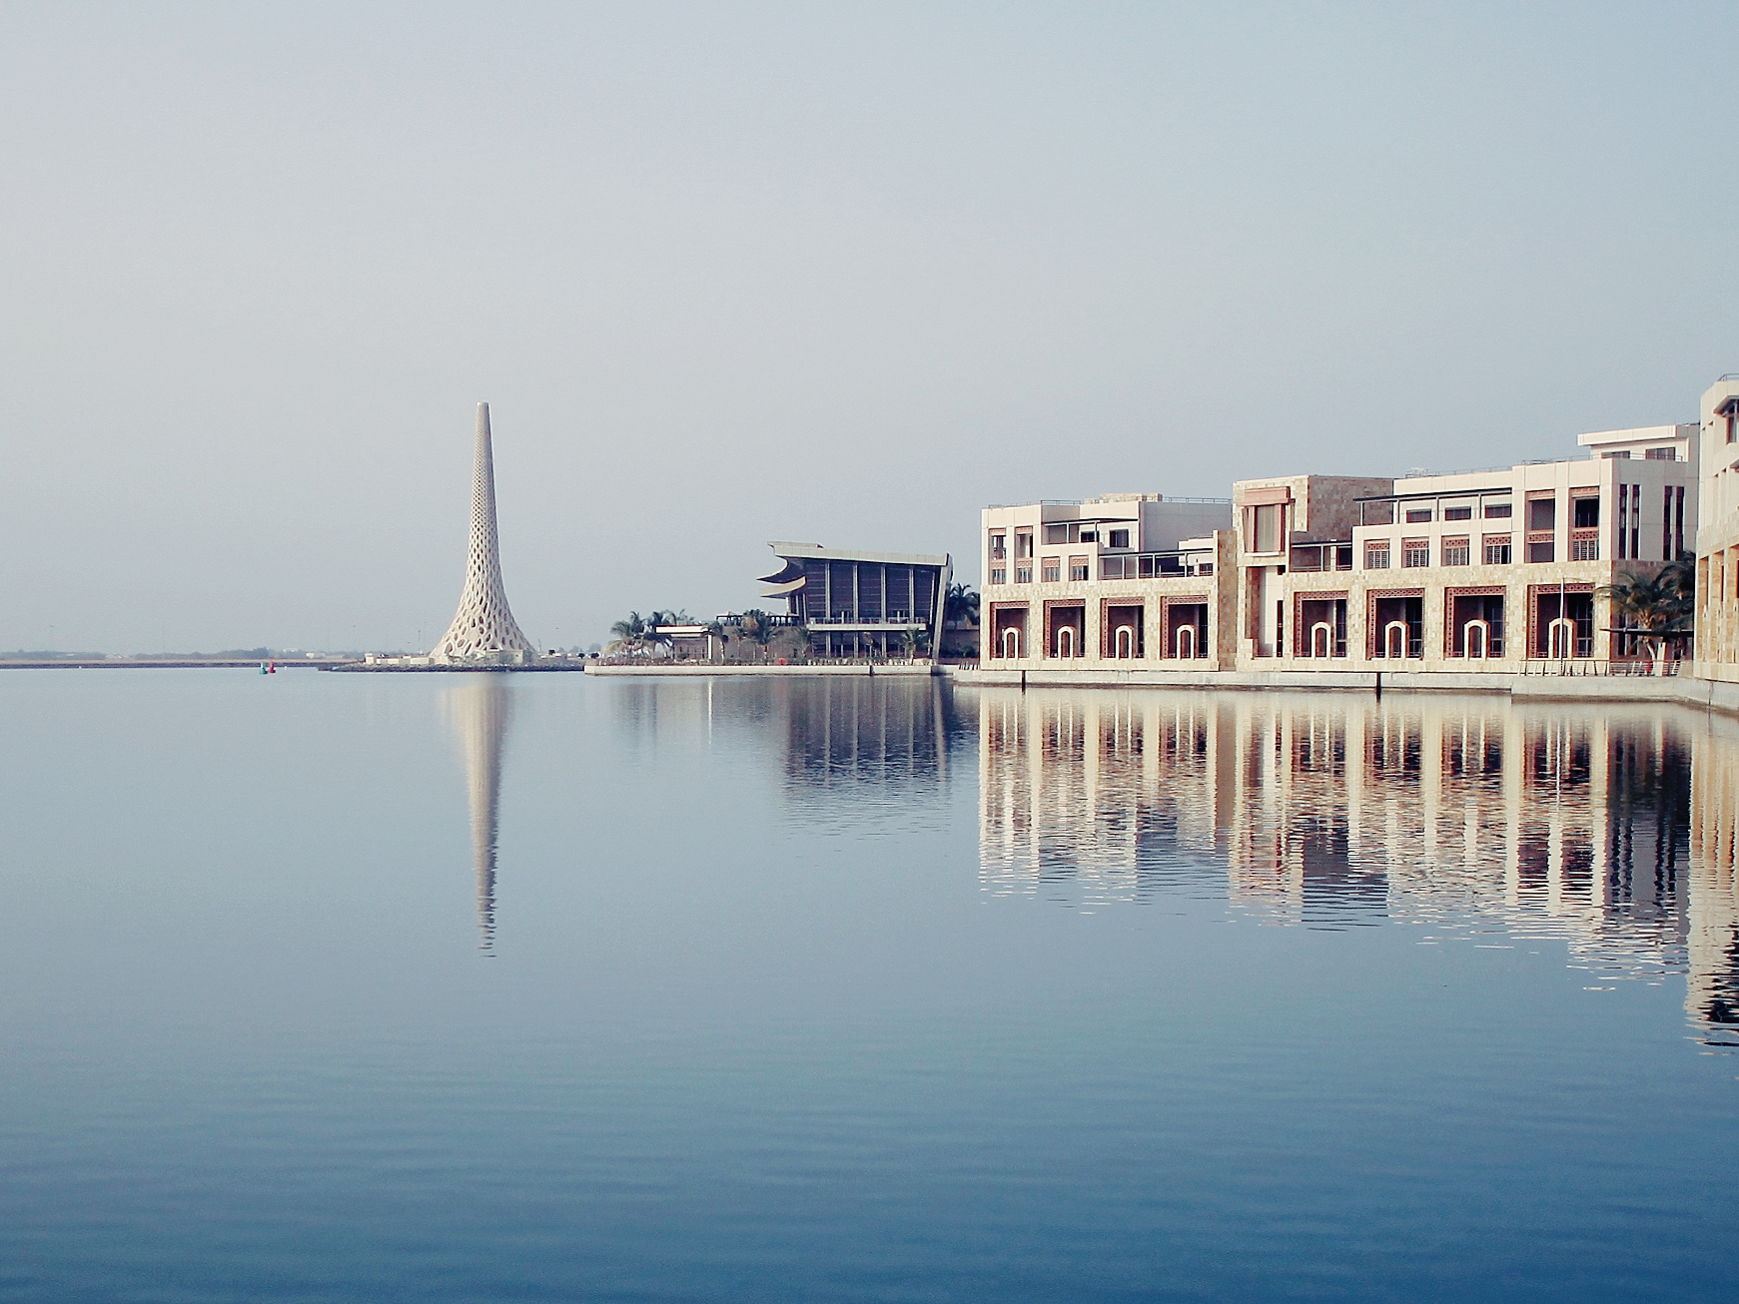
Research in BESE focuses on the molecular and cellular mechanisms through which organisms sense, adapt and respond to the environment, and the development of innovative technologies.

Slide 3
BESE RESEARCH FOCUS
Modifying Technologies:
Food and Water Availability Human activity Extreme conditions Diseases (gene/environment)
Adaptive Mechanisms:
Genomic Molecular Cellular Sensing Signaling

Slide 4
Bionest – from bench to innovation
euroscience
pigenetics
tem cell biology
echnology

Slide 5
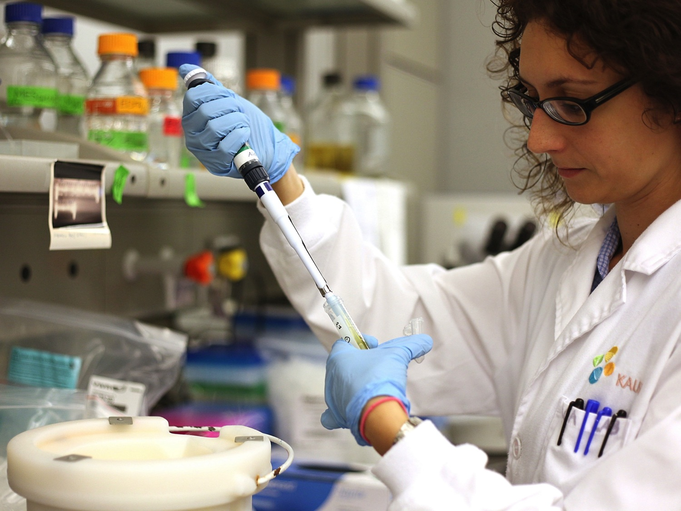
Research in the BESE Division is driven by independent Faculty labs (organized in Faculty Communities) and Research Centers, which Faculty can affiliate with to perform applied, goal-oriented research.
In addition, divisional research is supported by KAUST’s world class Core Labs.

Slide 6
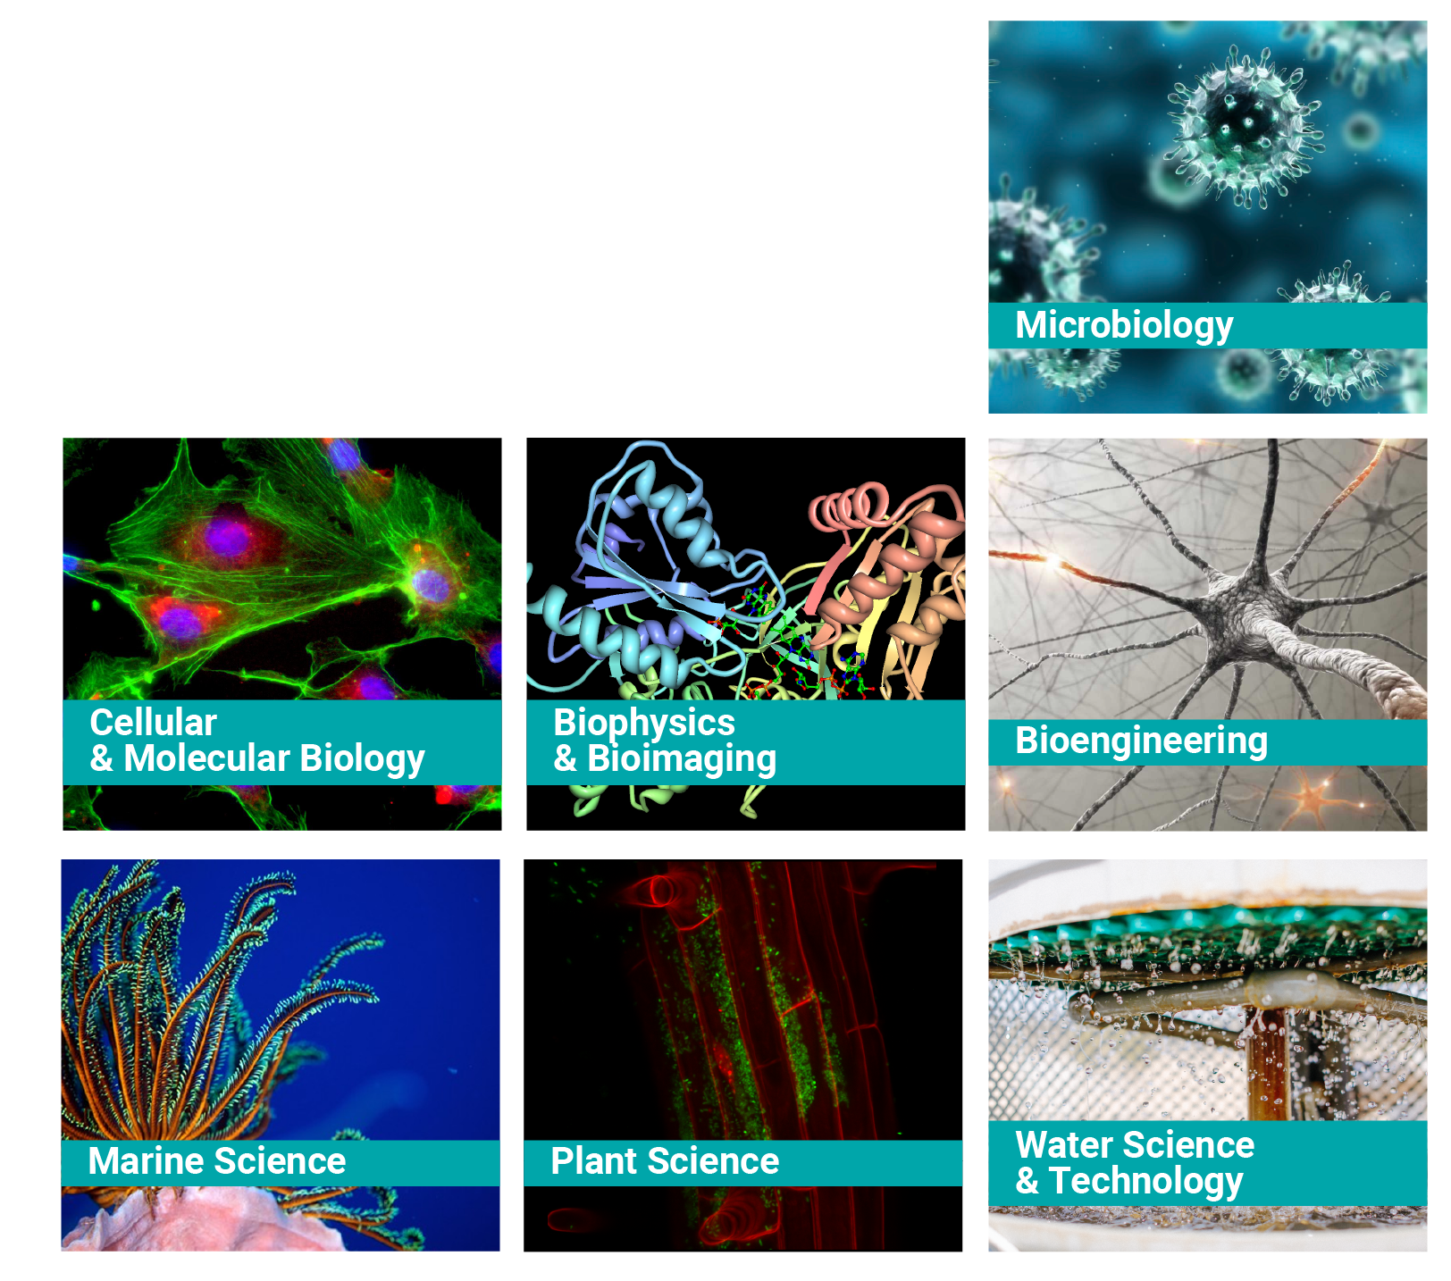
BESE
RESEARCH AREAS
/ FACULTY COMMUNITIES

Slide 7
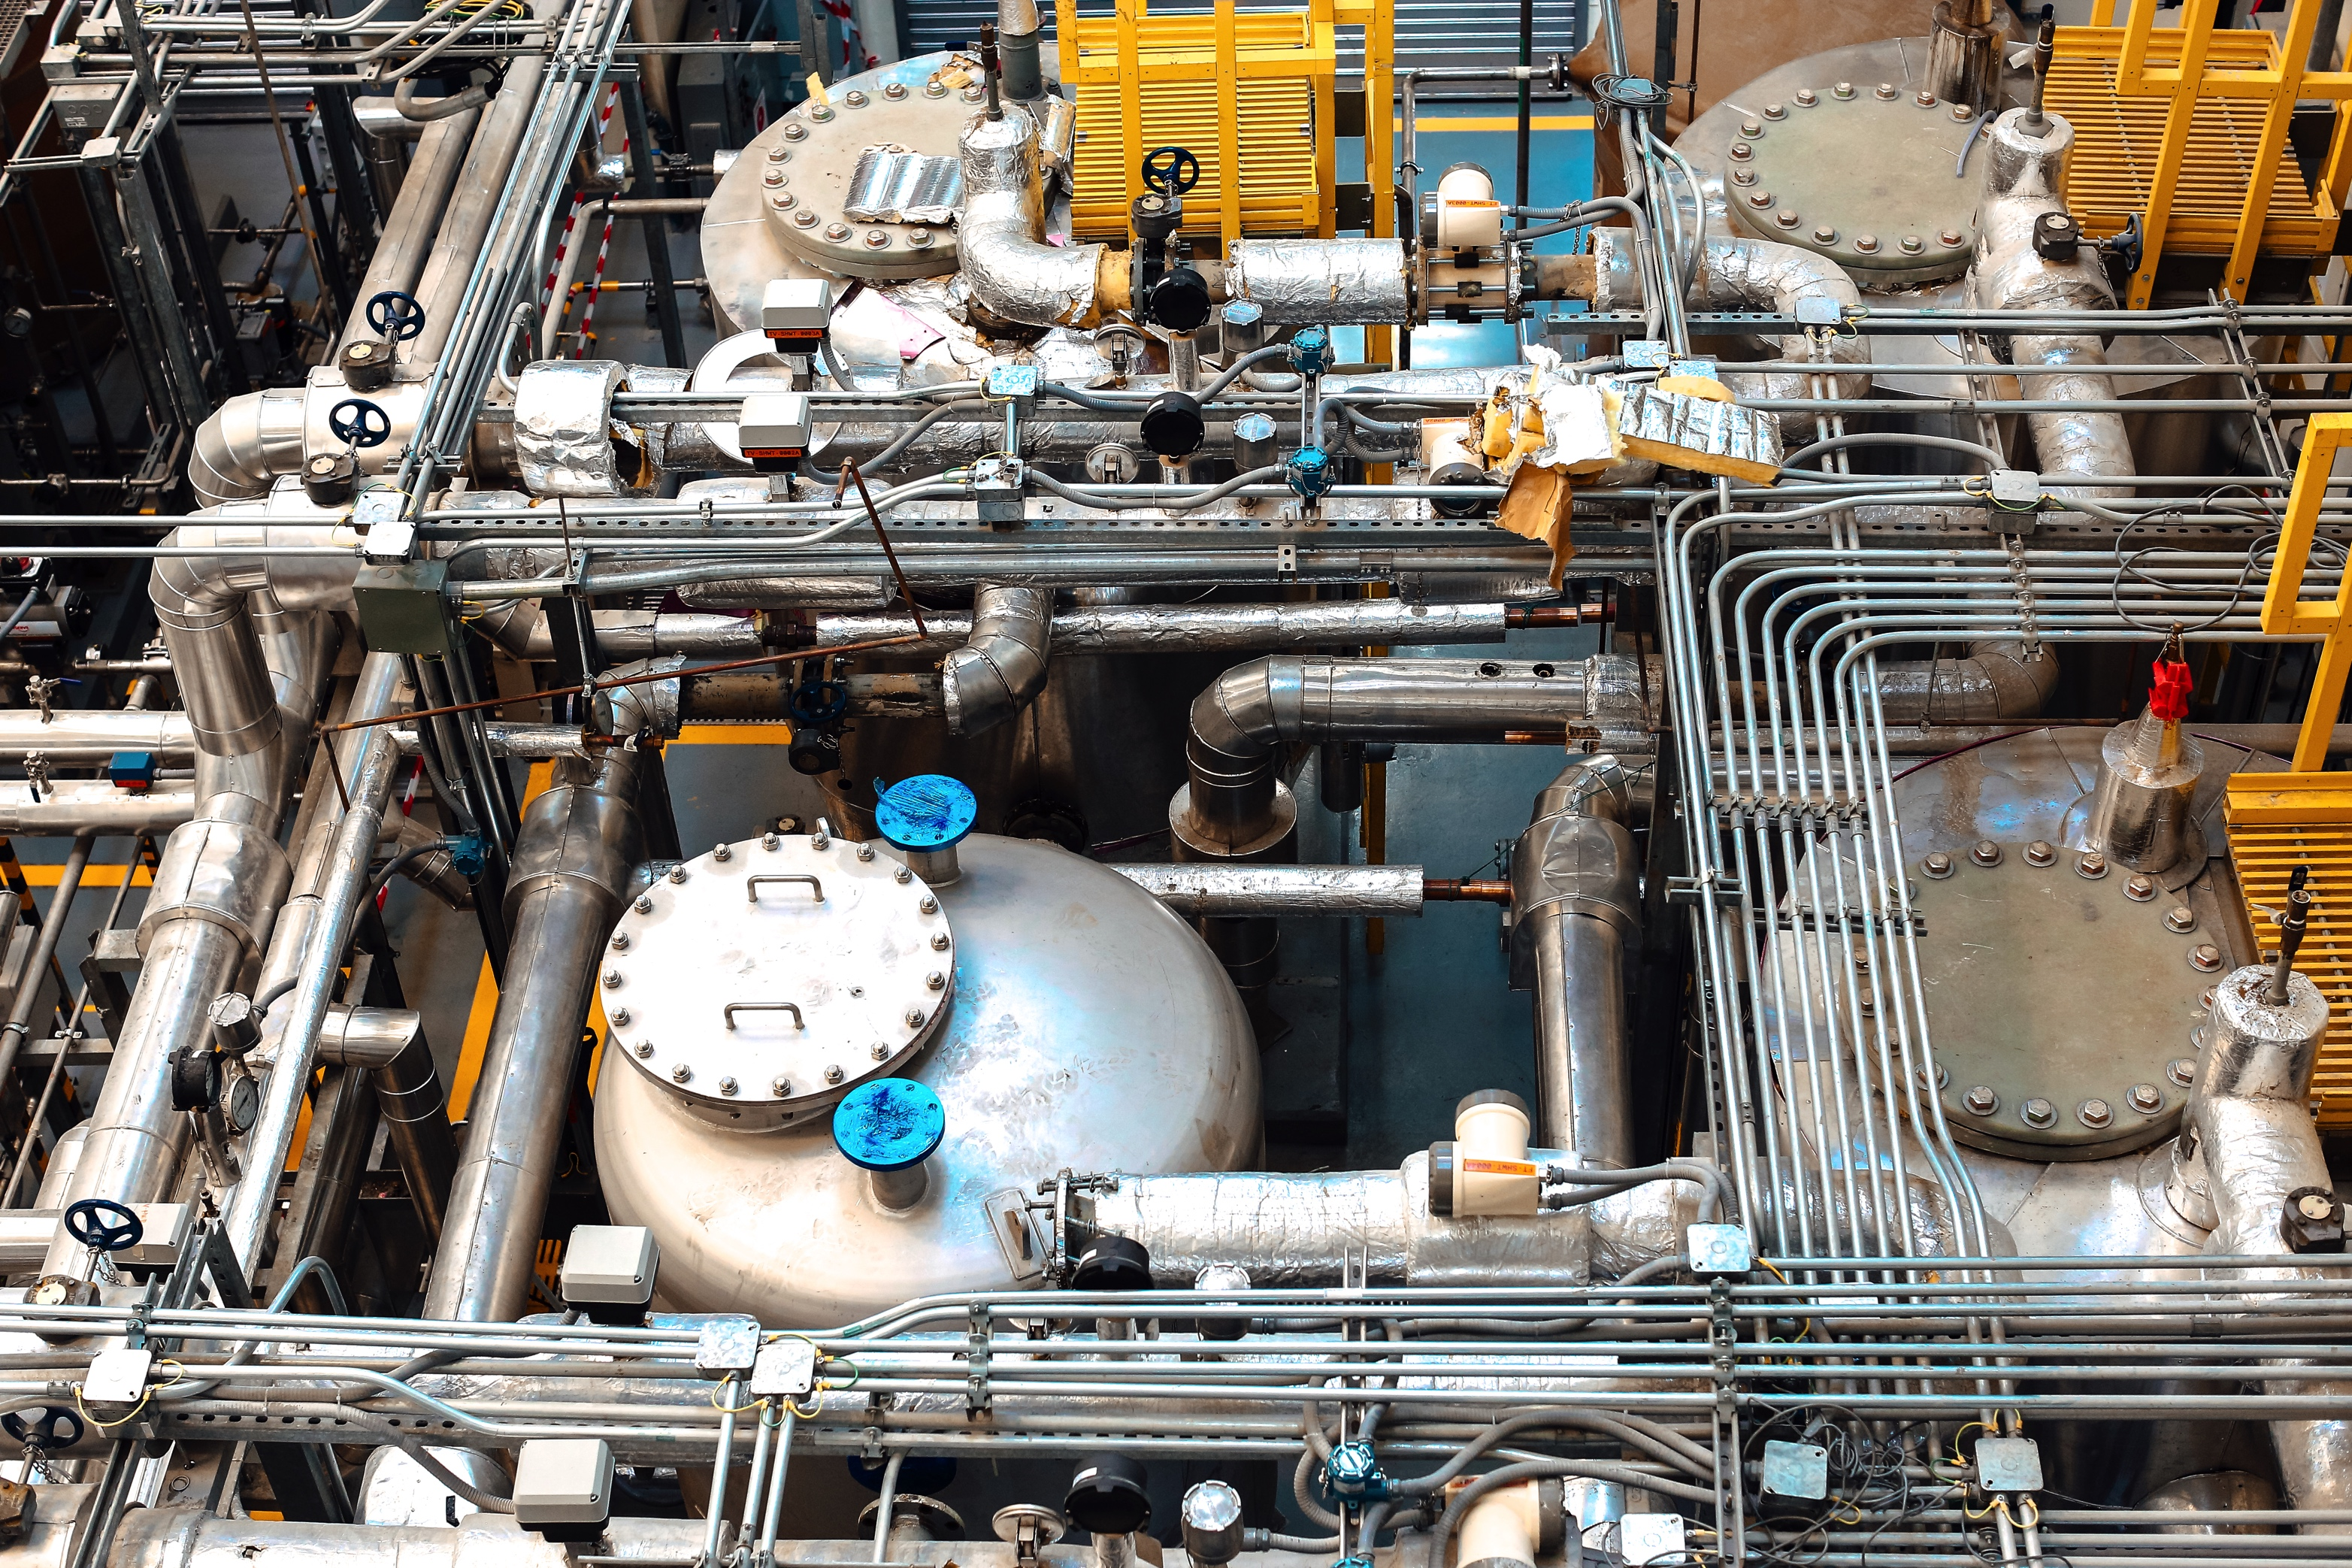
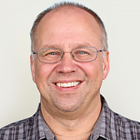
Water desalination & reuse center
In the KAUST Water Desalination and Reuse Center (WDRC), they develop and optimize methods to improve water desalination processes to provide potable water in drought-stricken areas.
This is especially important in desert regions where seawater can be a drought-proof water resource. They also develop water reclamation and reuse strategies and processes to sustain scarce water resources.
Hans Vrouwenvelder Director

Slide 8
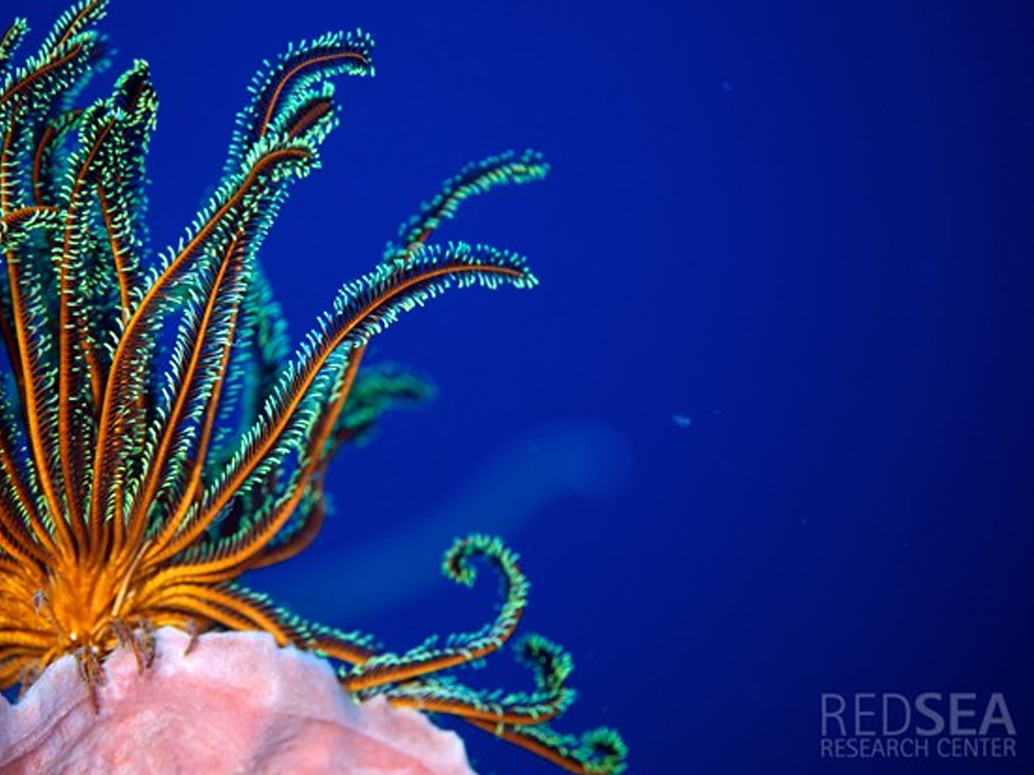
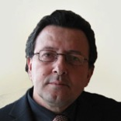
Red sea research center
The mission of the Red Sea Research Center (RSRC) is to contribute to the understanding of the role, functioning and response to pressures of the global ocean by using the unique opportunities offered by the Red Sea
The RSRC aims to provide critical scientific knowledge underpinning the role of the Red Sea in supporting the growth of a Blue Economy for the Kingdom of Saudi Arabia.
Carlos Duarte Director

Slide 9
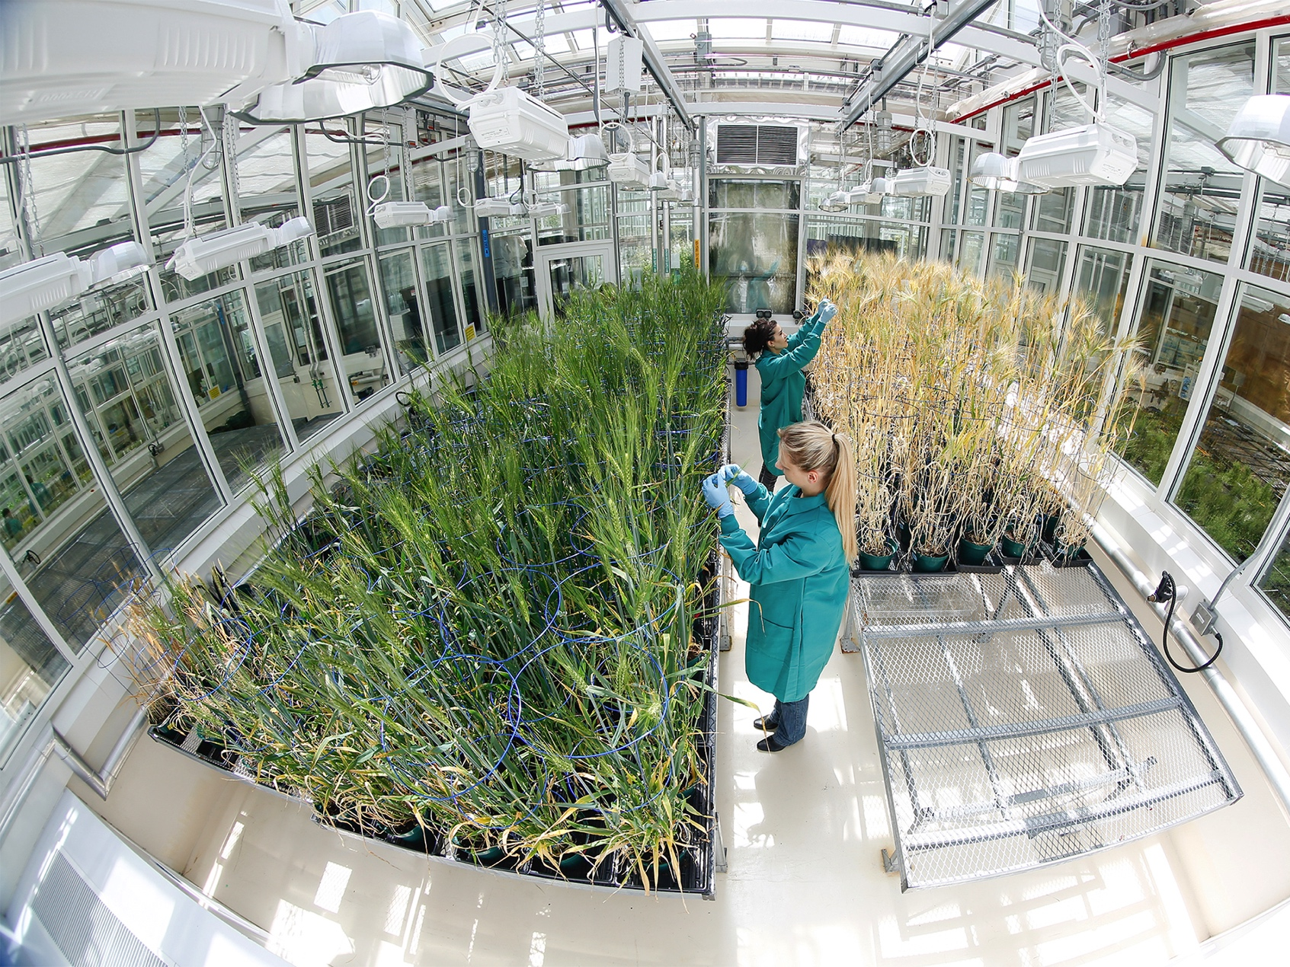
DESERT AGRICULTURE INITIATIVE
The Desert Agriculture Initiative seeks to tackle the wider suite of difficult challenges posed by agriculture in a desert environment under hot climate and poor freshwater conditions by bringing together a variety of skills and expertise both within and beyond KAUST.

Slide 10
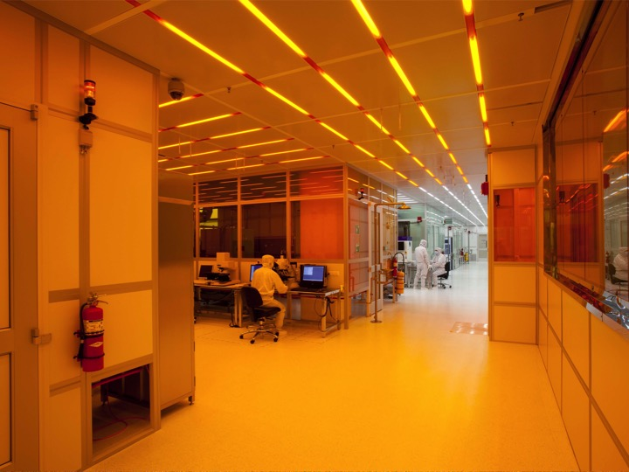
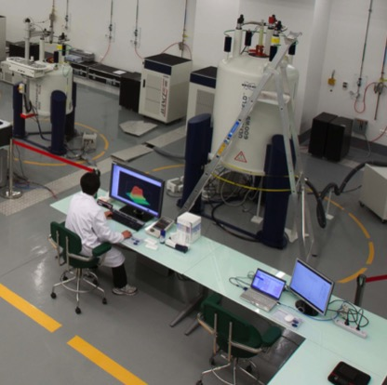
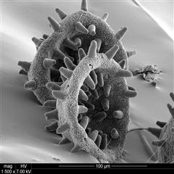
Advanced nanofabrication imaging & characterization core lab
TEM
Morphology, Immunolabeling and 3D Rendering
SEM
Imaging for wet and biological samples
Optical microscopy
Fluorescence, deep tissue and live cell imaging
NMR
Biomolecular structure analysis
12 NMR (up to 900 MHz)

Slide 11
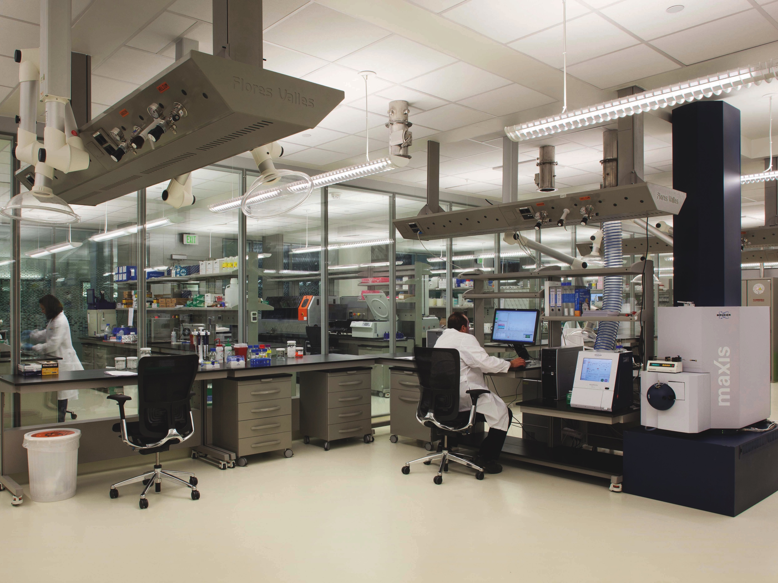
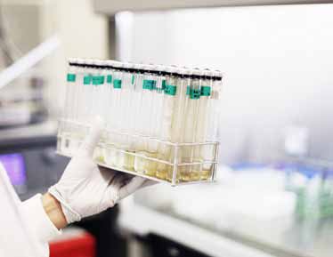

The bioscience core lab
Genomics (sequencing)
De novo, transcriptome, miRNA, ChIP Seq
Proteomics
Protein/peptide/metabolite identification
Cell Sorting
Analyze and define cell populations – single cell analysis

Slide 12
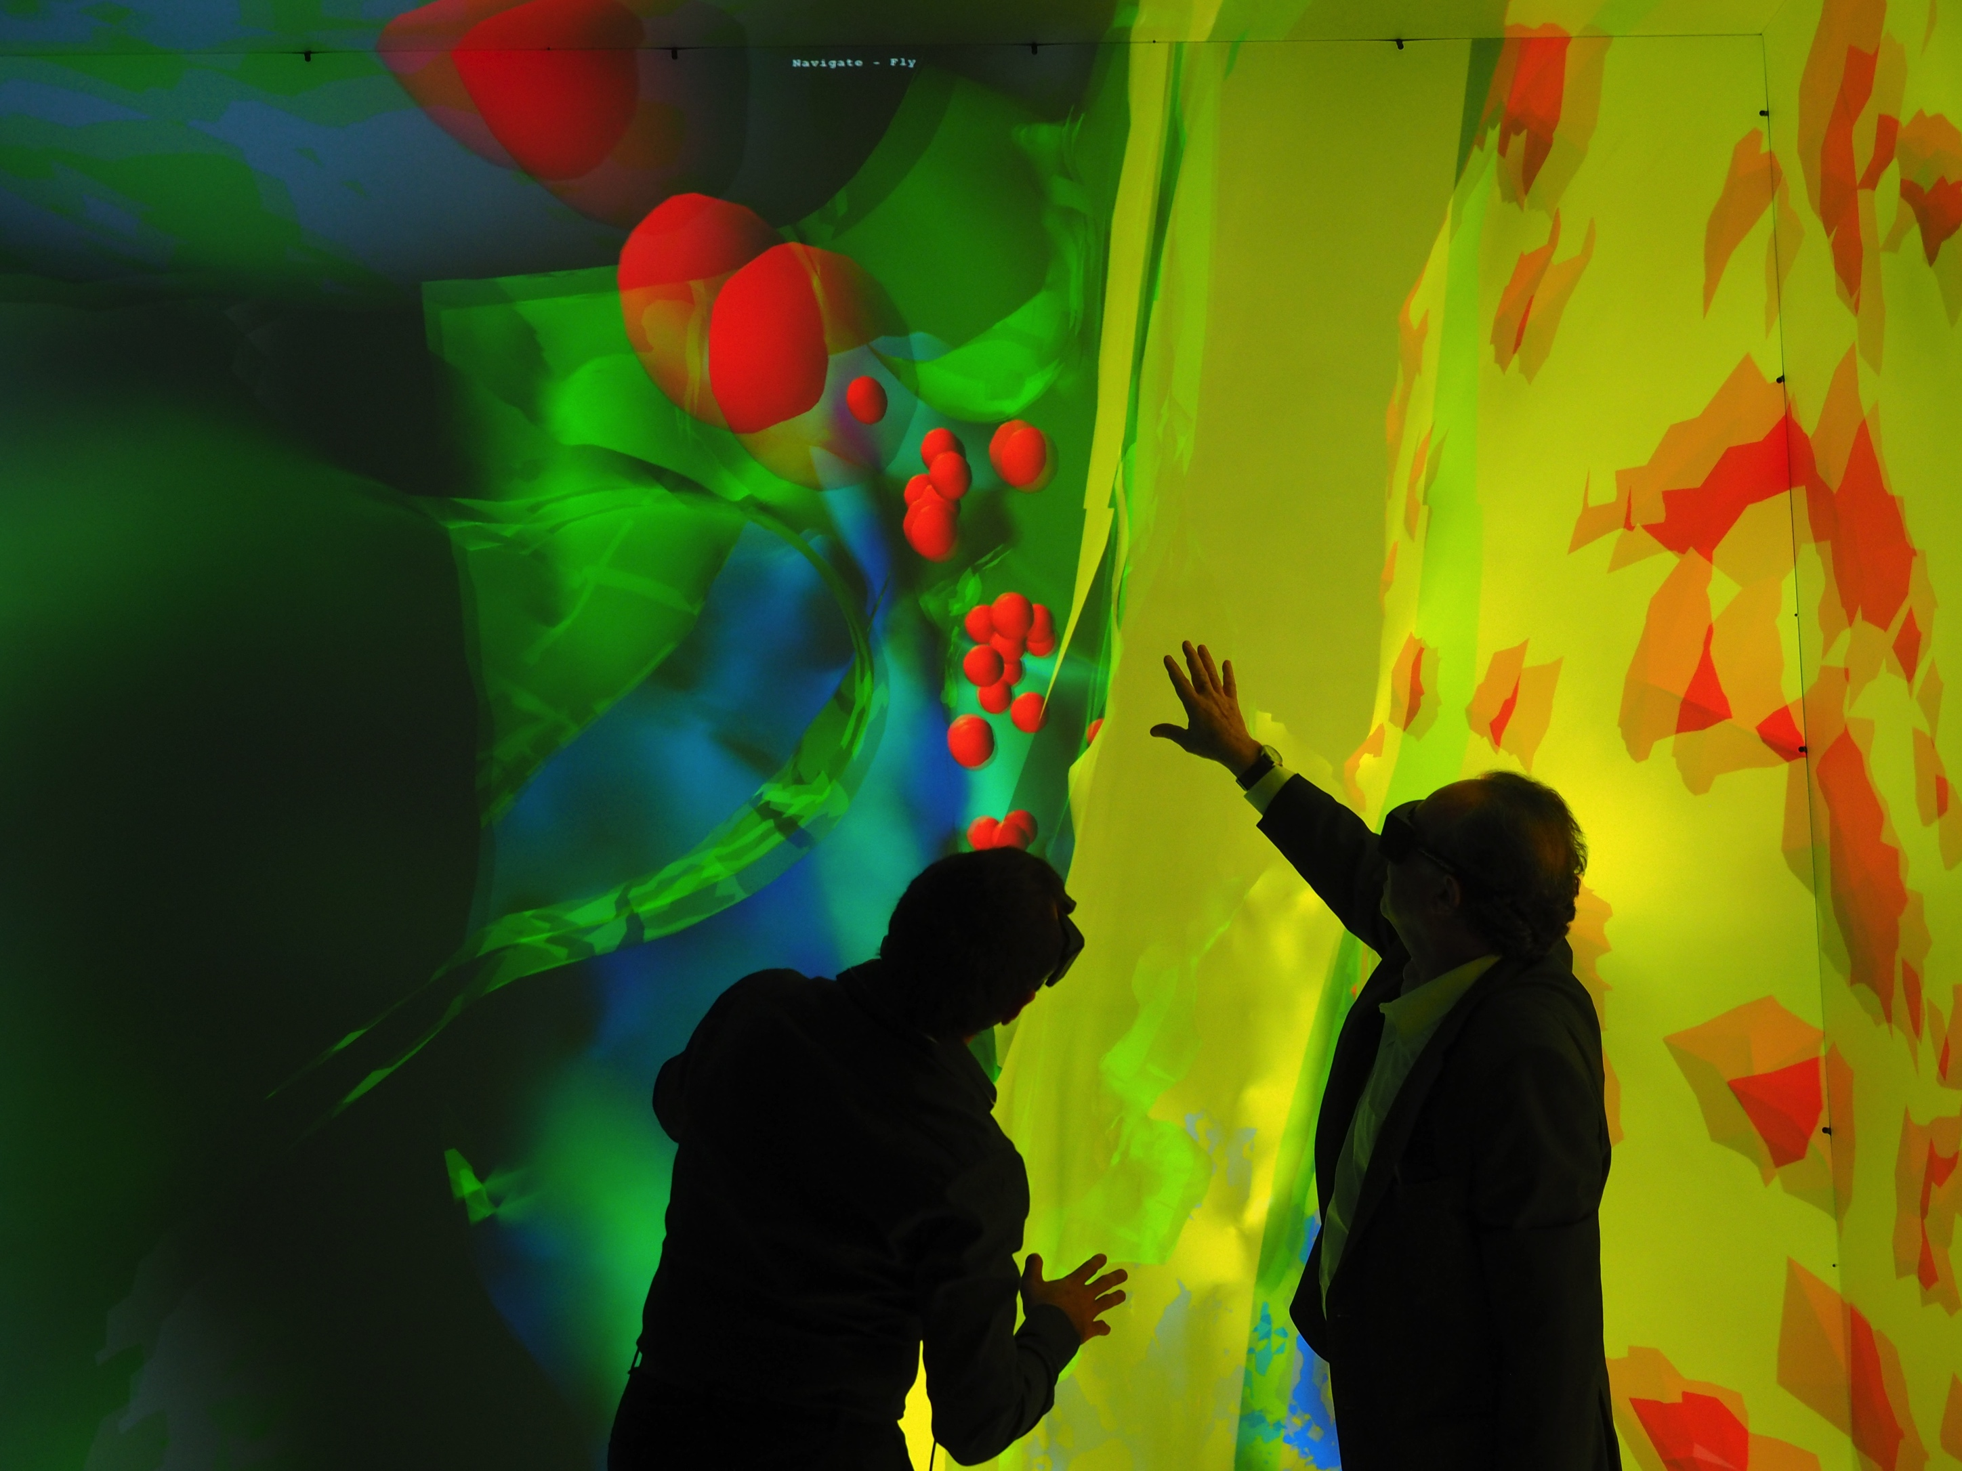
The Cornea cave as a research tool
Exploring a reconstruction of brain tissue in the KAUST Cornea Cave

Slide 13
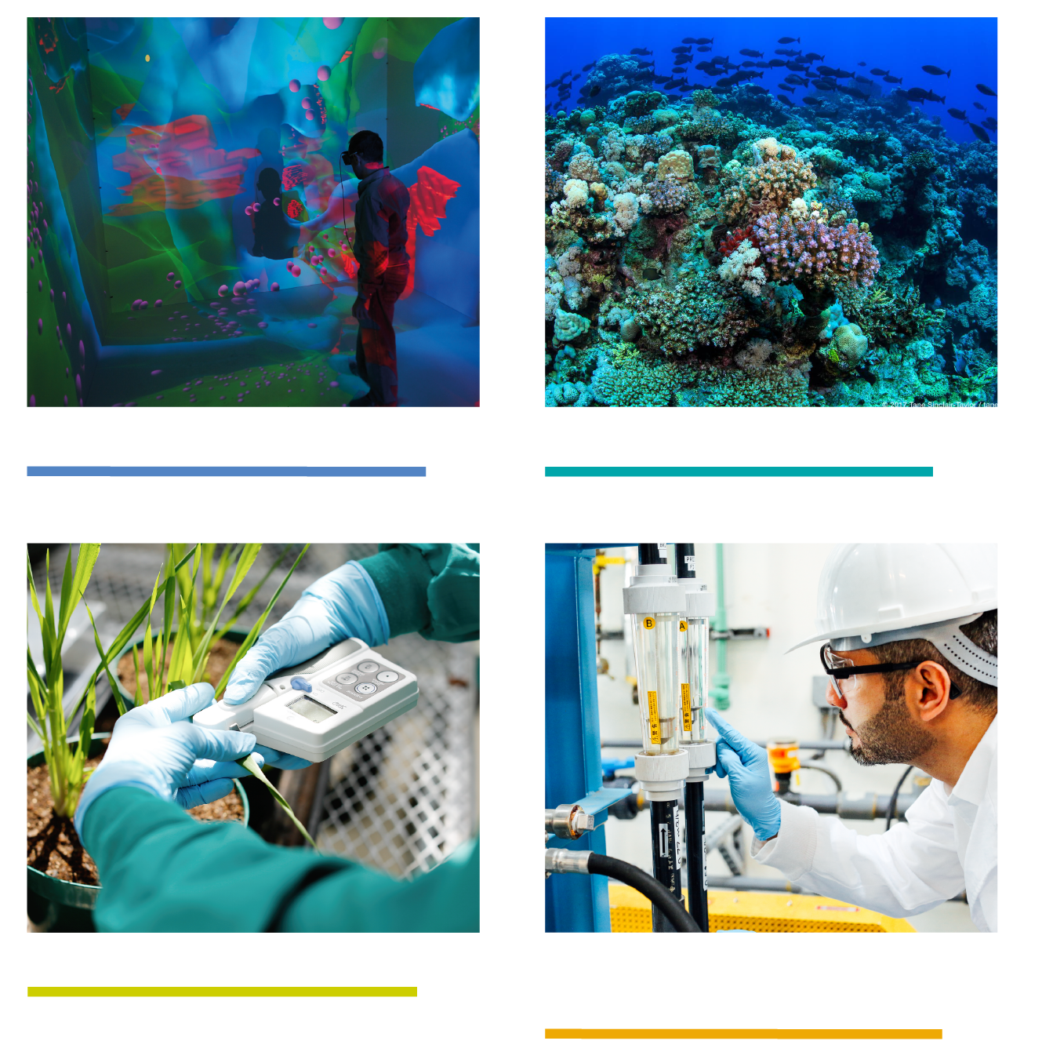
BESE
ACADEMIC
PROGRAMS

Slide 14
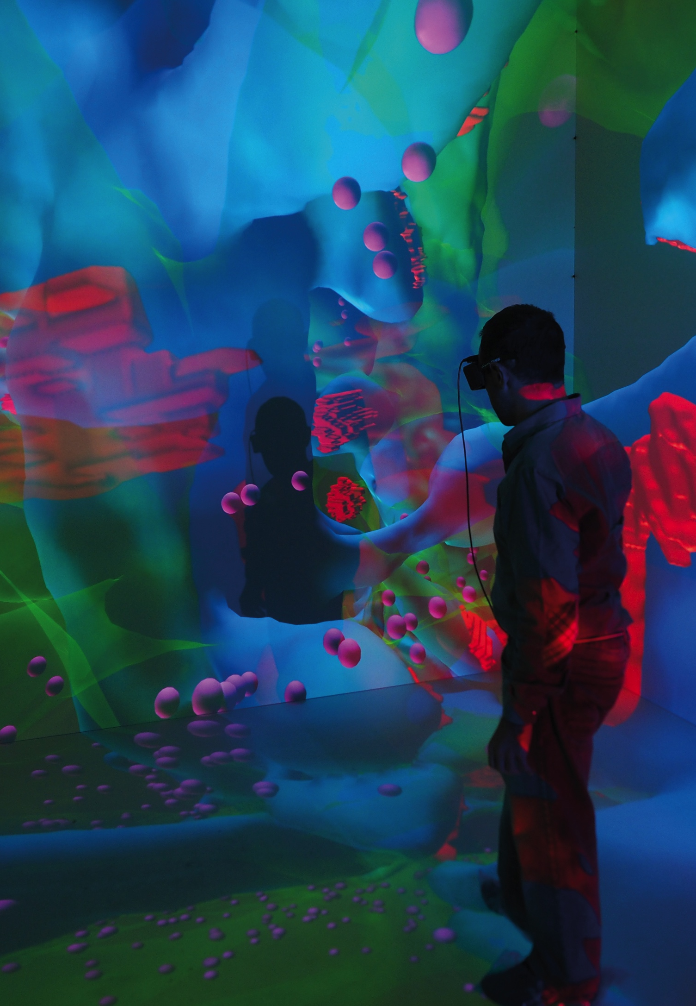
BESE ACADEMIC PROGRAMS
BIOSCIENCE
PROGRAM
The Bioscience program plays a key role in tackling many of the global challenges being addressed by KAUST, with a general emphasis on what we term Adaptive Biology or the study of the mechanisms that allow organisms to adapt to their environment.

Slide 15
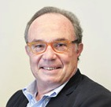
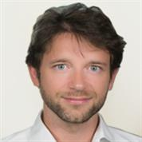
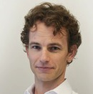
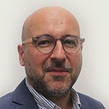
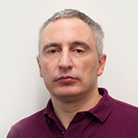
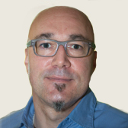
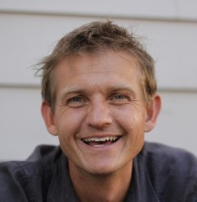
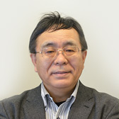
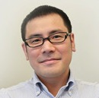
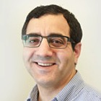
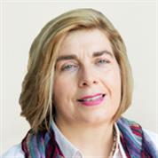
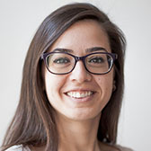
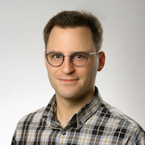
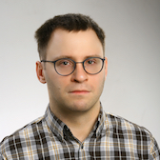
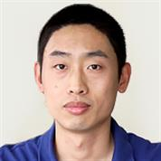
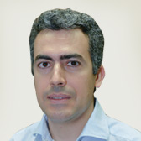
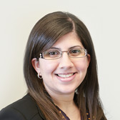
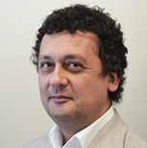
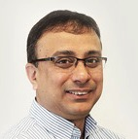
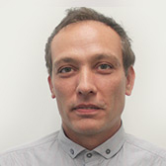
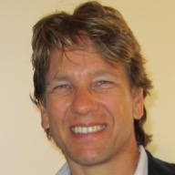
BIOSCIENCE FACULTY
Pierre Magistretti Dean BESE
Antonio Adamo
Stefan Arold
Daniele Daffonchio
Andrea Falqui
Wolfgang Fischle
Christian Frokjaer Jensen
Takashi Gojobori
Satoshi Habuchi
Samir Hamdan Program Chair
Charlotte Hauser
Sahika Inal
Lukasz Jaremko
Mariusz Jaremko
Mo Li
Carlo Liberale
Jasmeen Merzaban
Valerio Orlando
Arnab Pain
Timothy Ravasi
Jesper Tegner

Slide 16
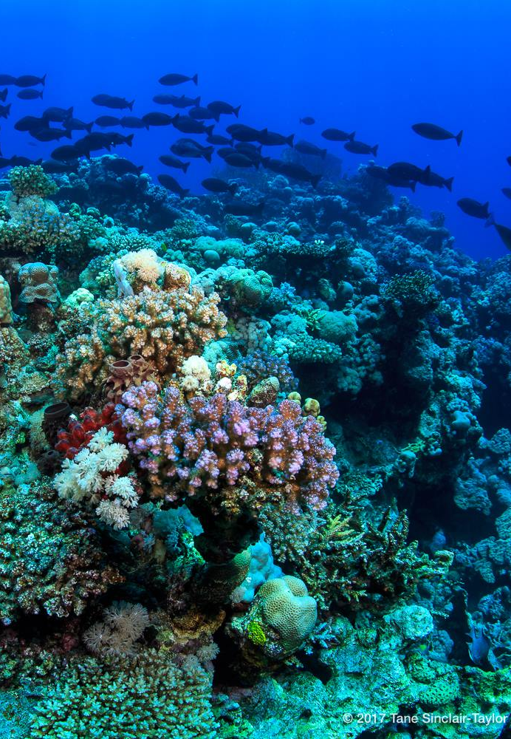
BESE ACADEMIC PROGRAMS
MARINE SCIENCE
PROGRAM
The Marine Science (MarS) Program takes advantage of KAUST’s location on the Red Sea, a living laboratory with great potential for exciting science.
The program addresses the biology and ecology of the multitude of marine life forms.

Slide 17

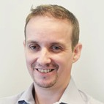
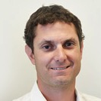
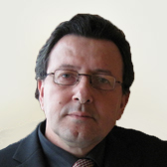
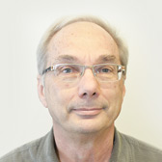
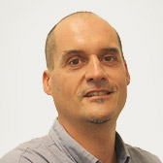
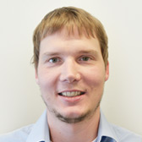
Marine SCIENCE FACULTY
Susana Agusti
Manuel Aranda
Michael Berumen Program Chair
Carlos Duarte
Burton Jones
Xelu Moran
Christian Voolstra

Slide 18
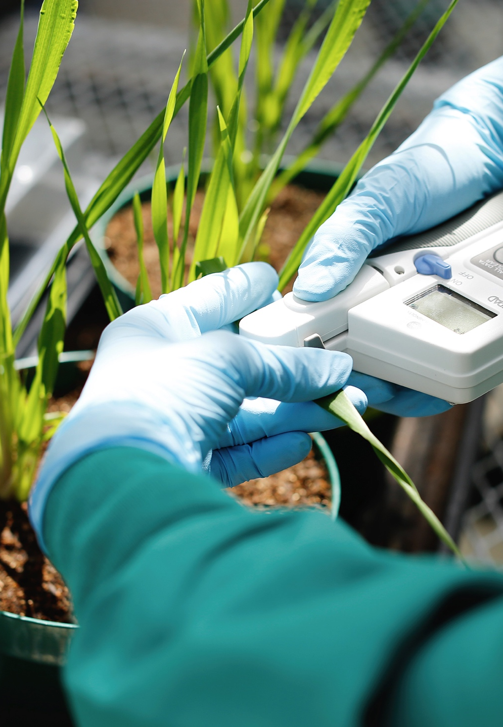
BESE ACADEMIC PROGRAMS
PLANT SCIENCE
PROGRAM
The goal of the Plant Science Program is to develop a thorough understanding of plant growth and function under challenging environmental conditions, such as those found in Saudi Arabia.

Slide 19
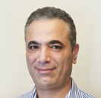
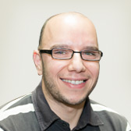
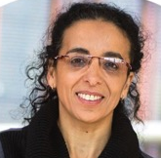
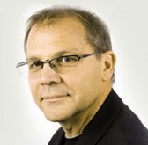



PLANT SCIENCE FACULTY
Salim Al-Babili Program Chair
Moussa Benhamed
Ikram Blilou
Heribert Hirt
Simon Krattinger
Magdy Mahfouz
Mark Tester

Slide 20

BESE ACADEMIC PROGRAMS
ENVIRONMENTAL
SCIENCE
& ENGINEERING
PROGRAM
The Environmental Science and Engineering Program (EnSE) examines methods to purify and reuse water, as well as to reduce contamination of existing reserves.
The focus of the program is on examining the impact of humans on our environment through resource exploitation; including over-consumption, land degradation, and pollution of water.

Slide 21









Environmental science & engineering FACULTY
NorEddine Ghaffour
Peiying Hong
TorOve Leiknes
Matthew McCabe
Himanshu Mishra
Kim Choon NG
Suzana Nunes Associate Dean
Pascal Saikaly Program Chair
Hans Vrouwenvelder
Peng Wang

Slide 22

Thank you!

Slide 23
Program orientations to follow:
Marine Science Building 2 · Level 5 · Room 5209
Bioscience Building 2 · Level 5 · Room 5220
Environmental Science and Engineering Building 4 · Level 5 · Room 5209
Plant Science Building 3 · Level 5 · Room 5209

